Slide 1
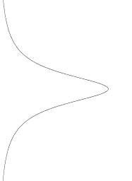
Intensity (number of photons) in a flat screen follows a Cauchy distribution
Point light source

Slide 2


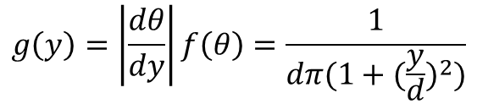

The angular distribution of the photons in $\left(−\frac{π}{2},\frac{π}{2}\right)$is uniform:
$$f\left(θ\right)= \frac{dθ}{π}$$
y
We have:
θ
$$tan\left(θ\right)= \frac{y}{d} → θ=atan⁡(\frac{y}{d})$$
Point light source
y=0
d
Thus we can derive the PDF of y:
$$g\left(y\right)=\left|\frac{dθ}{dy}\right|f\left(θ\right)=\frac{1}{dπ(1+{(\frac{y}{d})}^{2})}$$
Which is a Cauchy distribution

